Slide 1
Front End Engineering-I Project
Team Details:
Muskan 2310991365
Pratham Kumar 2310991348
Aditya Thakur 2310991383
Faculty Coordinator:
Mr. Neeraj Singla
:
Chitkara University Institute of Engineering and Technology,
Chitkara University, Punjab

Slide 2
Table of Contents
Introduction
Problem Statement
Technical Details
Key Features
Project Highlights
Conclusion
References/Links used

Slide 3
Introduction
Purpose Definition: Clearly define the purpose of the special event. Whether it's a product launch, conference, birthday celebration, or any other significant occasion, make sure your audience understands why it's special.
Choose a Countdown Tool: Select a reliable countdown timer tool or widget. You can find various options online that allow you to customize the design and embed it on your website or share it through social media.
Website Integration: If you have a website, integrate the countdown timer prominently on your homepage or a dedicated event page. Ensure it's easily visible and accessible to your visitors.
Social Media Announcements: Utilize your social media platforms to announce the upcoming special event and include the countdown timer. Share visually appealing graphics or posts to catch your audience's attention.
Email Campaigns: If you have an email list, send out newsletters or emails announcing the event and include the countdown timer. Encourage your subscribers to mark their calendars.

Slide 4
Problem Statement
Limited Technical Resources: Small businesses or individuals may lack the technical expertise or resources to seamlessly integrate a countdown timer into their websites or promotional materials.
Platform Compatibility: The diverse range of platforms (websites, social media, emails) where the countdown needs to be displayed poses a challenge. Ensuring a consistent and visually appealing countdown across different platforms can be technically demanding.
Engagement Decay: Maintaining audience interest over an extended countdown period can be challenging. The initial excitement may wane, leading to decreased engagement as the event approaches.
Communication Strategy: Effectively communicating the purpose and significance of the event through the countdown requires a well-thought-out strategy. Without a compelling narrative, the countdown may fail to generate the desired level of anticipation.

Slide 5
Technical Details
Event Date Format:
Ensure the event is the correct format (YYYY-MM-DDTHH:mm:ss)
to be parsed correctly by JavaScript’s ‘Date’ object.
Responsive Design:
Make sure the countdown timer is responsive by testing its appearances on various devices and screen sizes. You can use media queries in your CSS for responsiveness.
Browser Compatibility:
Test the countdown timer on different browsers to ensure compatibility. Adjust your code if any browser-specific issues arise.
Accessibility Considerations:
Ensure that your countdown timer is accessible by providing alternative text for screen readers and considering keyboard navigation.
Countdown Pausing:
Implement optional features like pausing or restarting the countdown if needed. This adds flexibility in case event details change.

Slide 6
Key Features
Customizable Design: Allow users to customize the design of the countdown timer to match their website or event theme. This includes the ability to choose colors, fonts, and styles.
Responsive Layout: Ensure the countdown timer is responsive and adapts to different screen sizes and devices, providing a seamless user experience on desktops, tablets, and smartphones.
Multiple Display Formats: Offer various display formats for the countdown, such as days, hours, minutes, and seconds. Additionally, provide an option for different styles, like flip clocks, digital displays, or traditional numeric formats
Countdown Animation: Incorporate smooth animations to make the countdown visually appealing. Animations can include transitions between numbers or dynamic effects to draw attention.
Event Details: Include a section to display key details about the special event, such as the event name, date, time, and a brief description. This provides context for users who may be discovering the event for the first time.

Slide 7
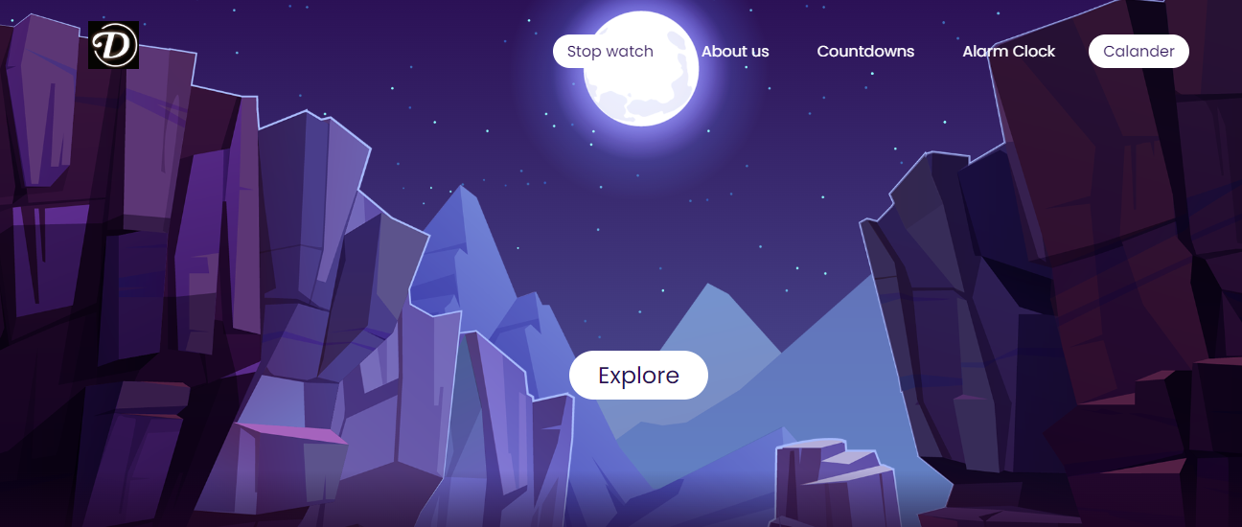
PROJECT HIGHLIGHTS

Slide 8
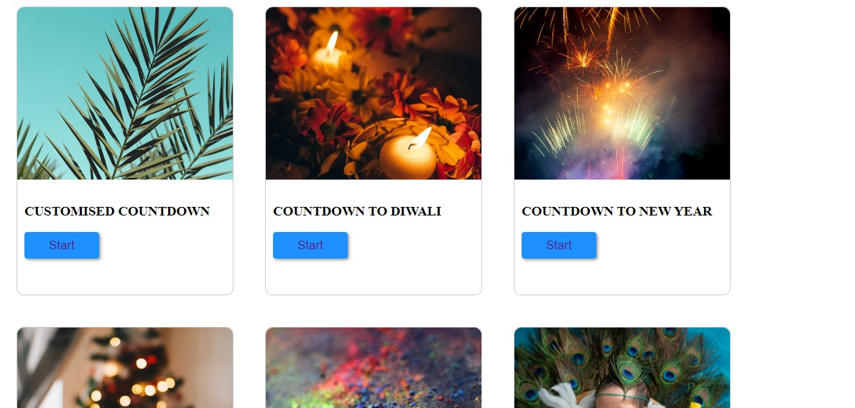
Project Highlights

Slide 9
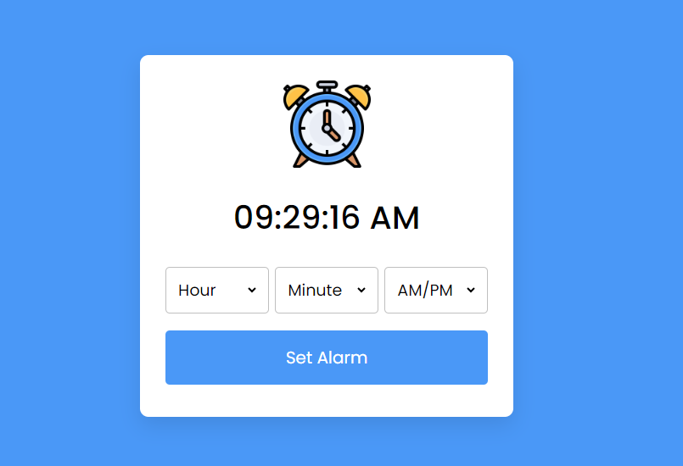

Slide 10
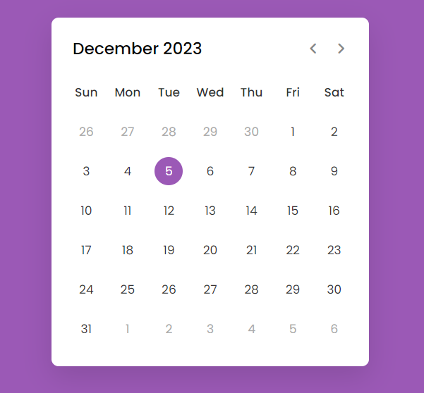
Project Highlights

Slide 11
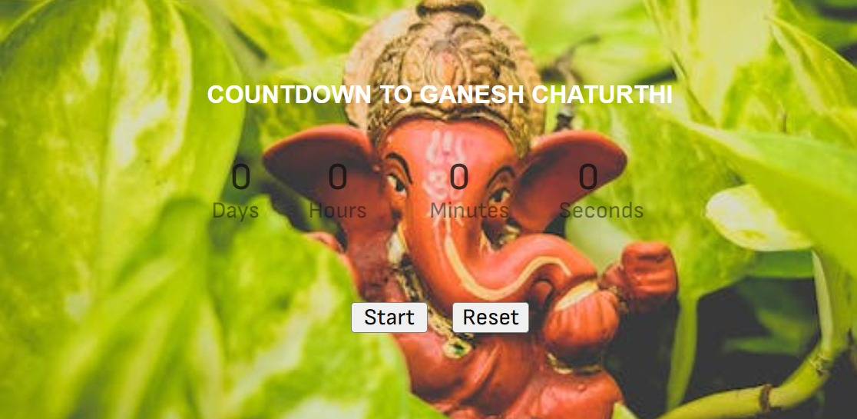
Project Highlights

Slide 12
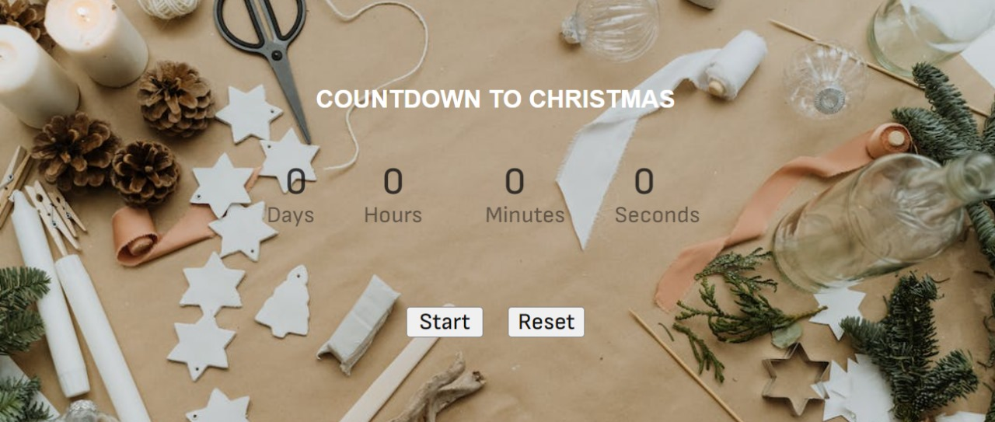
Project Highlights

Slide 13
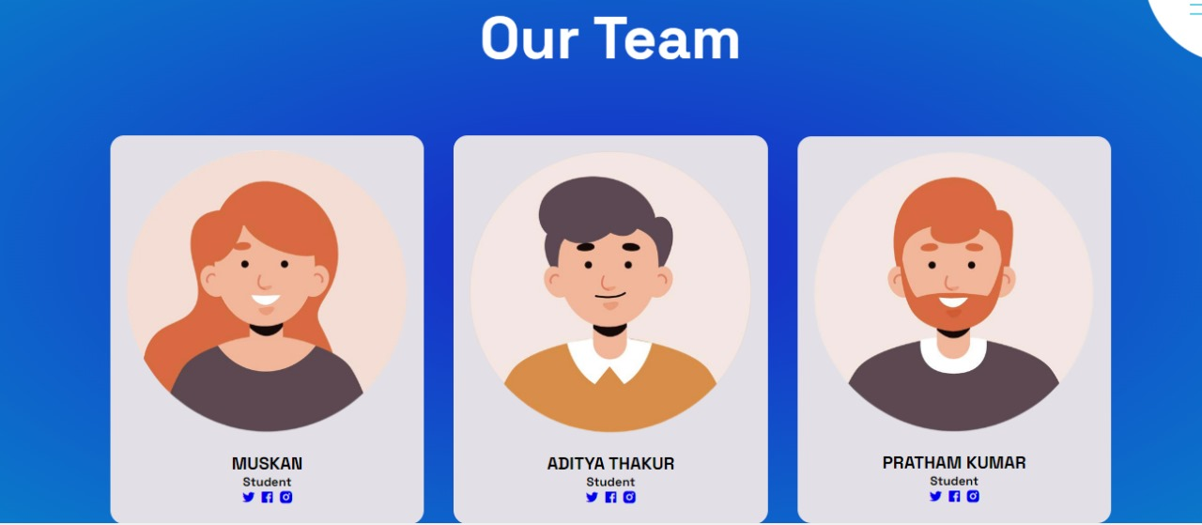
Project Highlights

Slide 14
Conclusion
Engagement and Anticipation: A well-designed countdown timer serves as a focal point, capturing attention and instilling a sense of excitement. The visual representation of time ticking down creates a compelling narrative that keeps users engaged.
User-Friendly Features: Responsive layouts, multiple display formats, and intuitive features enhance the user experience. Enabling users to preview, pause, and restart the countdown contributes to a user-friendly interface.
Social Media Integration and Sharing: Social media integration facilitates organic promotion as users share the countdown with their networks. This viral effect extends the reach of the event and generates additional excitement.
Analytics and Insights: Integration with analytics provides valuable insights into user engagement patterns. These data-driven observations enable organizers to fine-tune their strategies and understand the impact of the countdown on audience behavior.

Slide 15
References/Links used
W3 School:
Html and CSS: https://www.w3schools.com/html/default.asp /
CSS Trick:
CSSTricks.com URL: https://css-tricks.com/

Slide 16


